Slide 1
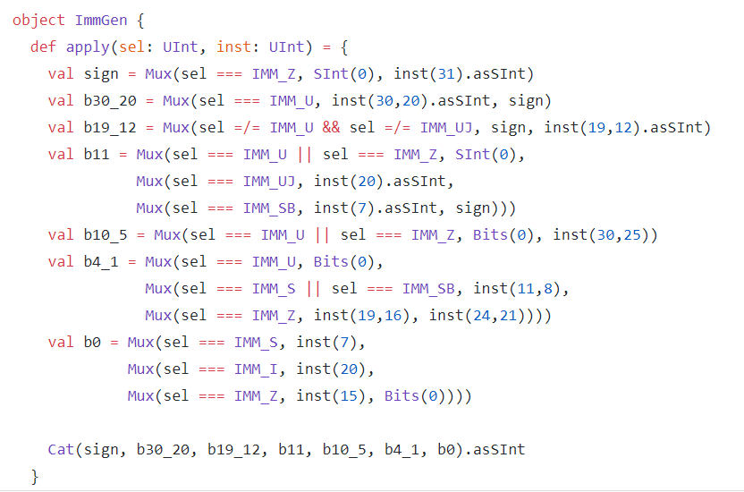
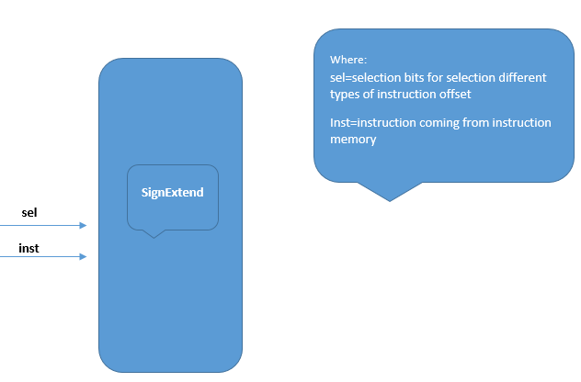
Rocket Chip Decode Block : Sign Extend

Slide 2
We have created object ImmGen and define a function name apply which takes two parameters sel=select lines for MUX inst=instruction coming from instruction Memory
We then created immutable variable sign and use Mux in it .If our sel is equal to IMM_Z (IMM_Z in this condition is pointing to 0 offset, it will select SINT(0) otherwise it will select 31th bit from the instruction)

Slide 3
We created an immutable variable b30_20 in which we select immediate bits for Utype instruction. If sel is equals to IMM_U(IMM_U in our case is pointing as selection bits for MUX)
If our instruction is of U type Mux will extract bits from 20 to 30 from the instruction otherwise Mux will select sign variable which we declared above
We created an immutable variable b19_12 in which we uses Mux and compared two immediate of U and UJ type instruction if our sel is not pointing towards IMM_U and IMM_UJ we will select sign variable which we declared above, otherwise if Mux condition false we will extract bits from 12 to 19 from our instructions and converts it in Signed integer

Slide 4
We create an immutable variable b11 which select one bit from different Mux conditions on the basis of sel bits
We have 1st Mux in which have OR condition between sel bits weather it points to IMM_U OR it points towards IMM_Z sel.If any of the above condition satisfies we will select Signed Integer(0)
But If our 1st Mux condition lies in false we have 2nd Mux which will compare sel bits with IMM_UJ (immediate of Unconditional jump) if sel is equal to IMM_UJ we will select 20th bit from the instruction and convert it SignedInteger
If sel is not equals to IMM_UJ which means selection bits is not the same as IMM_UJ sel bits then we have our 3rd Mux comes into play in which we compare sel with IMM_SB(immediate of Store Branch) if 3rd Mux Condition satisfies we extract 7th bit from the instruction and converts it in SignedInteger otherwise we will select sign variable which we declared above

Slide 5
We created a immutable variable b10_5 for selection of bits from 25 to 30 .We use Mux condition which compare sel with IMM_U OR sel with IMM_Z if any of the condition true we select Bits(0) otherwise we extract instruction bits from 25 to 30
We created a immutable variable b4_1 for selection of bits from 8 to 11 or 21 to 24 .We use Mux condition which compare sel with IMM_U if this condition satisfies we select Bits(0) otherwise
We use 2nd Mux condition which compares sel with IMM_S and IMM_SB if any of these condition true we extract bits 8 to 11 from our instruction
If 2nd Mux condition doesn’t satisfies we use 3rd Mux which will compare sel with IMM_Z,if this condition satisfies we extract bits from 16 to 19 from our instruction otherwise we extract bits from 21 to 24 from our instruction

Slide 6
We create a variable b0 which is selecting one bits from different Muxes condition
1st Mux will compare sel with IMM_S(immediate of store type instruction) if this condition satisfies we select 7th bit from the instruction
If 1st Mux condition fails we uses 2nd Mux condition which compare sel with IMM_I(immediate of I type instruction) if it satisfies we extract 20th bit from the instruction
If 2nd Mux doesn’t satisfies we uses 3rd Mux which compares sel with IMM_Z if this condition satisfies we extract bit 15 from our instruction otherwise bits (0) will be selected
We use Cat function in order to concatenate all the bits which we extracted from different immutable variables and then convert them in SignedInteger

